Slide 1
CPSC 323: Compilers and Languages Lexical Analysis
Mr. Kavil Jain
Teaching Associate
Mail: kjain@fullerton.edu
Reference : Prof Doina Bein & Prof James Choi

Slide 2
Introduction
Lexical analysis is the initial phase in the compilation process. It is also known as scanning or tokenization
Its role is to break down the source code into basic building blocks known as tokens, by removing any whitespace or comments in the source code.
Reference: Tutorials Point

Slide 3
Tokens
A token is the basic building block of source code.
Examples of tokens include keywords, identifiers, literals (constants), operators, and punctuation marks.

Slide 4
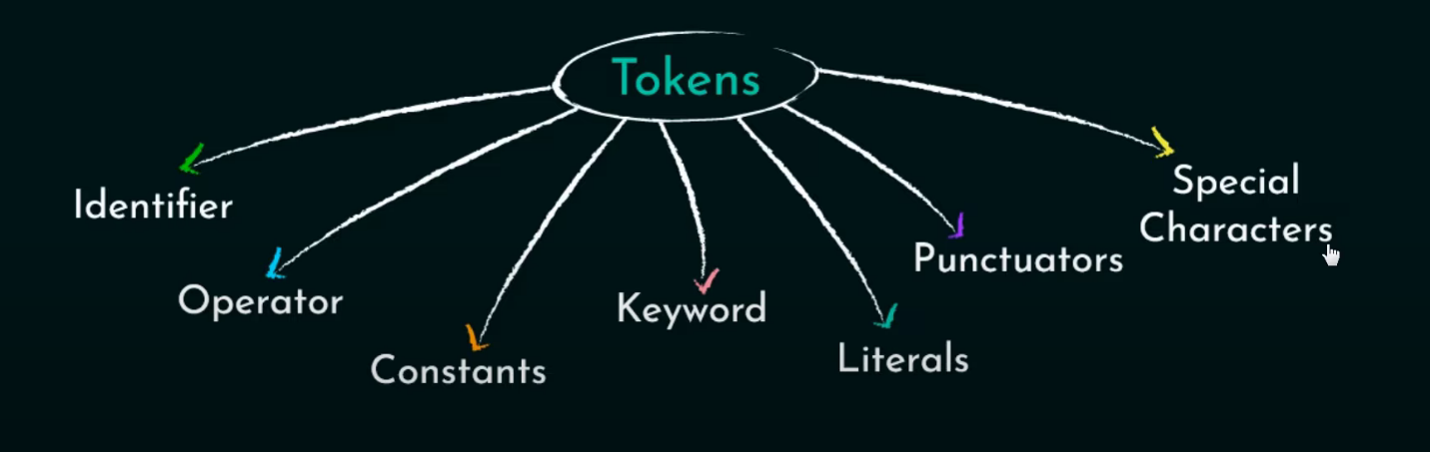
Types of Tokens

Slide 5
Keywords
Reserved words with special meanings in the programming language (e.g., if, else, for).
Identifiers
User-defined names for variables, functions, or other entities (e.g., variableName, calculateTotal).
Literals / Constants
Constants representing fixed values (e.g., numeric literals like 123, string literals like "Hello").
Operators
Symbols that perform operations on operands (e.g., arithmetic operators +, -, relational operators ==, !=).
Separators / Punctuators
Special Symbols
Characters that delimit or separate portions of code (e.g., ,, ;, (, ), {, })
Miscellaneous symbols with special meanings (e.g, . for member access, @, $, &, #)

Slide 6
Lexemes
A lexeme is a sequence of characters in the source program that matches the pattern for a token.
For example, in the expression int age = 25;, the lexemes include:
int (matches the pattern for a keyword),
age (matches the pattern for an identifier),
= (matches the pattern for an operator),
25 (matches the pattern for a numeric literal),
; (matches the pattern for a separator).
Lexemes | Tokens
int | Keyword
age | Identifier
= | Operator
25 | Literal
; | Separator

Slide 7
Regular Expressions
Regular expressions define the patterns of tokens.
Used to describe the syntax of the language.
Examples:
Keyword: if|else
Identifier: [a-zA-Z][a-zA-Z0-9]*

Slide 8
Finite Automata
Finite automata are used to recognize and validate tokens based on regular expressions.
Illustrates the transition between states for different characters.
Provides a visual representation of token recognition.

Slide 9
Example of Tokenization
#include <stdio.h>
int main() {
int num1 = 10;
int num2 = 20;
int sum = num1 + num2;
printf("Sum: %d\n", sum);
return 0;
}

Slide 10
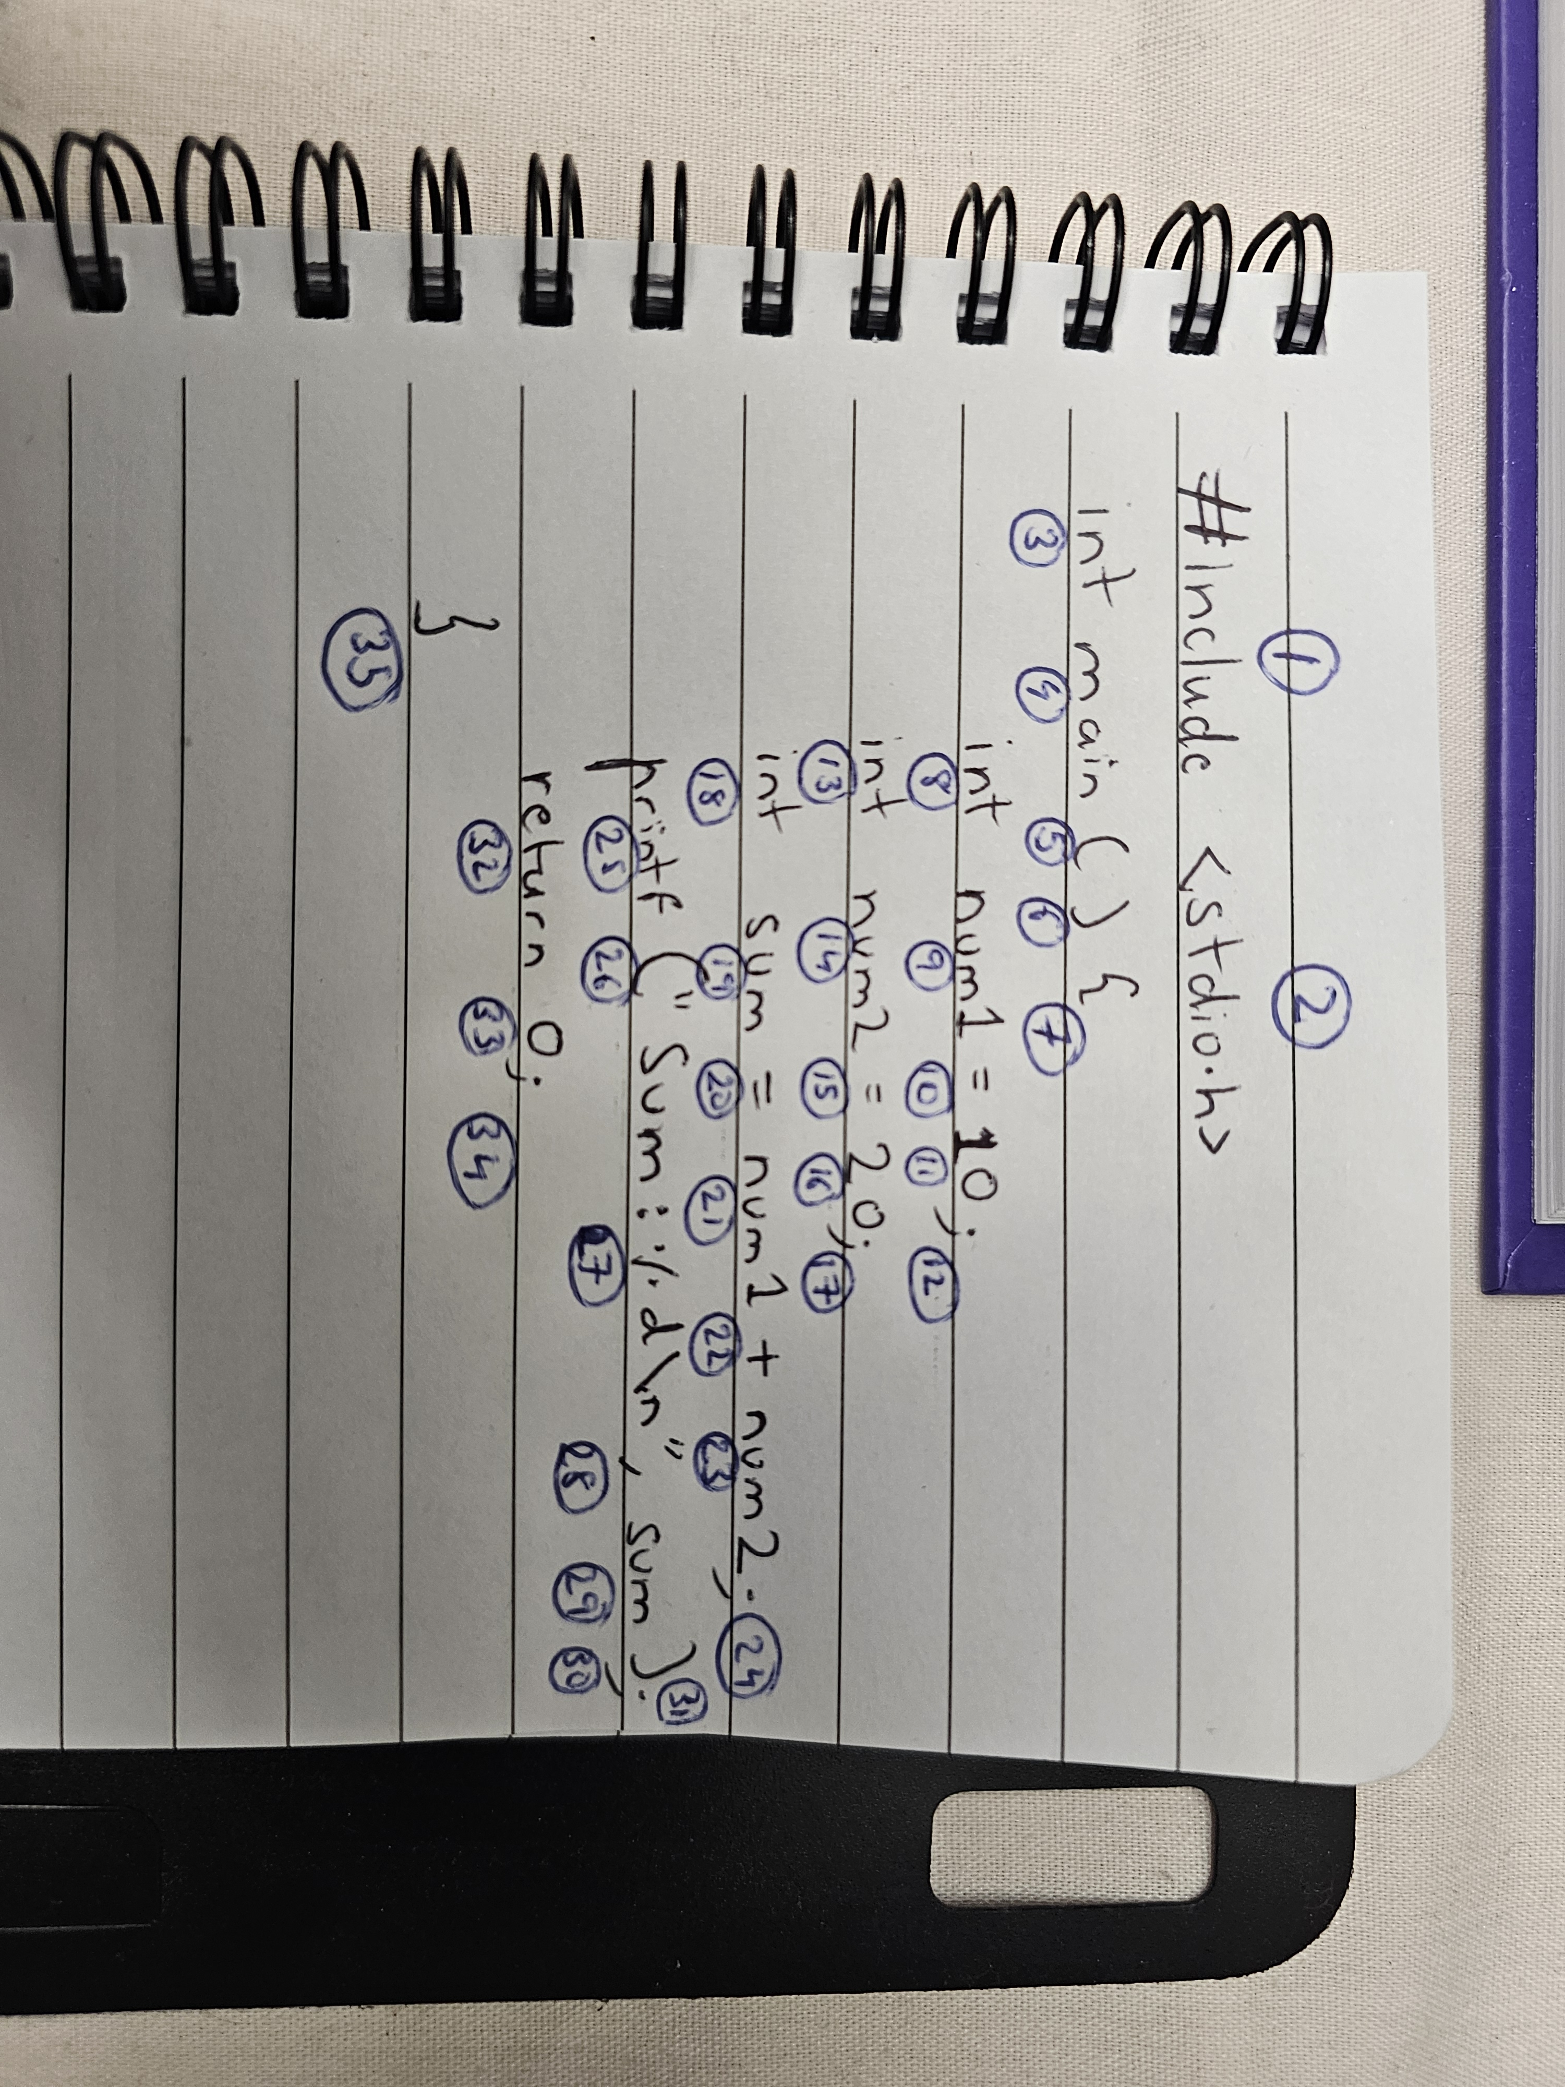
Explanation
Total number of Lexemes:
35

Slide 11
Answer
Lexeme | Token
#include | Keyword
<stdio.h> | Identifier (Header)
int | Keyword
main | Identifier
( | Separator
) | Separator
{ | Separator
int | Keyword
num1 | Identifier
= | Operator
10 | Literal
; | Separator
int | Keyword
num2 | Identifier
= | Operator
20 | Literal
; | Separator
Lexeme | Token
int | Keyword
sum | Identifier
= | Operator
num1 | Identifier
+ | Operator
num2 | Identifier
; | Separator
printf | Keyword
( | Separator
“Sum: %d\n" | Literal
, | Separator
sum | Identifier
) | Separator
; | Separator
return | Keyword
0 | Literal
; | Separator
} | Separator

Slide 12
Lexical Error
Exceeding length of numeric constants
e.g. int i = 3456789; // Size of int in 2 bytes (-32768 to 32767)
Numeric constants which are ill-formed
e.g. int i = 5467$2;
Illegal characters that are absent from the source code
char x[] = “CPSC 323”;$

